Slide 1
Git and other version control systems
or, overcoming objections
to using Git
or, telling your manager where
(s)he can stick it

Slide 2

github – automatic SVN import
git-svn – bridge that allows interop between a local git repository and a remote SVN repository
svn2git – migrates SVN repository to a git repository

Slide 3
github
Create github repository
Choose existing SVN repository import option
I’ve only gotten this to work *once*
There are documented problems with the authors import process
Any non-standard SVN layout that doesn’t use “trunk, tags, and branches” directories will cause problems

Slide 4
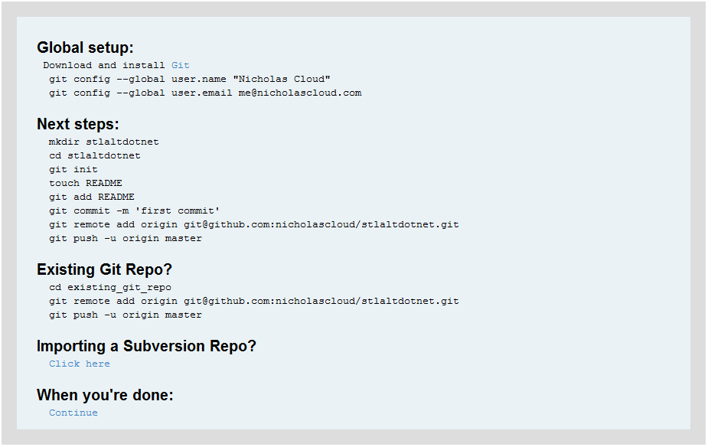

Slide 5
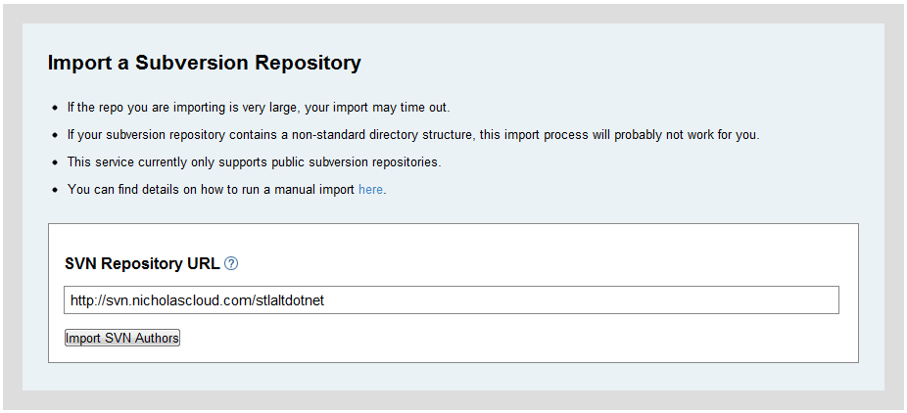

Slide 6
git-svn
git svn init [url-of-remote-svn-repository]
git svn fetch (pulls down repo structure)
git svn dcommit –username=[username] (commit changes to svn repository)
Because of the drastic difference between git and SVN merge implementations, it is recommended to use an actual SVN client for merges between SVN branches
http://www.kernel.org/pub/software/scm/git/docs/git-svn.html

Slide 7
svn2git
svn2git is a Ruby script that walks the history of an SVN repository and re-creates the history in a local git repository
It preserves history, branches, tags, and authors
I’ve run into problems using svn2git on Windows—I think this is related to line endings
Best to run svn2git in a Linux virtual machine
https://github.com/nirvdrum/svn2git

Slide 8
Download VirtualBox and the latest Ubuntu ISO
Create an Ubuntu virtual machine in VirtualBox
Install git and its dependencies:
sudo apt-get install git-core git-svn ruby rubygems vim
sudo gem install svn2git --source http://gemcutter.org
Create an SSH key pair and copy the public key to github
ssh-keygen –t rsa –C “me@nicholascloud.com”
use default options

Slide 9
Add the svn2git path to the end of your .profile file
vim ~/.profile
PATH=“$PATH:/var/lib/gems/1.8/bin”
(log out and then log back in)
Create a local directory for initial repository checkout; change to that directory
Create an “authors” file with a list of author handles in the format:
[svn-author] = [github-username] <[github-email>]

Slide 10
Run svn2git:
svn2git http://svn.nicholascloud.com/stlaltdotnet --verbose --authors ./authors
Run git branch to see that all your branches and tags have been created
Add your github remote to your new repository
git remote add origin git@github.com:nicholascloud/stlaltdotnet.git
Push your “master” branch
git push origin master
(enter credentials as prompted)

Slide 11
If you want to push additional branches to github, check them out locally and repeat the push process:
git checkout MyApp-v1
git push origin MyApp-v1
Go to gitub
Verify all branches were added
Verify commit history was added
Remove your temporary SSH key

Slide 12

git-tfs – a git/tfs bridge that allows interop, much like git-svn https://github.com/spraints/git-tfs
TFS2Git – PowerShell script that migrates a TFS repository to git, much like svn2git https://github.com/WilbertOnGithub/TFS2GIT

